Slide 1
* advanced applications of SCIANTIX, submitted for journal publication
SCIANTIX TUTORIALS (in parallel)
BASIC
ADVANCED MODELS *
DATA ASSIMILATION *
Github repository
phenomena & implementation
input files: general structure
simulation cases (constant conditions, transient, HBS)
basic outputs, plots
advanced model options: overview
development and implementation
Hands-on source code: editing and (re)-compiling
Machine Learning for SCIANTIX
application examples: open porosity, a-thermal gas release
external shell structure
Gaussian Process
application 1: diffusion coefficient
options and test cases
application 2: fuel melting temperature
options and result showcase
checks & post-processing
Final survey on tutorials
Live hands-on code and test cases → interactive sessions
Based on this general introduction, possible to choose now what to follow
Tutorials will be recorded, if you agree
Regardless of the tutorial you follow, recording and materials will be shared with everybody

Slide 2


BASIC TUTORIAL
Github repository
phenomena & implementation
input files
simulation cases
outputs & plots
Martina Di Gennaro, Alessio Magni
Lyon, 15.05.2024

Slide 3
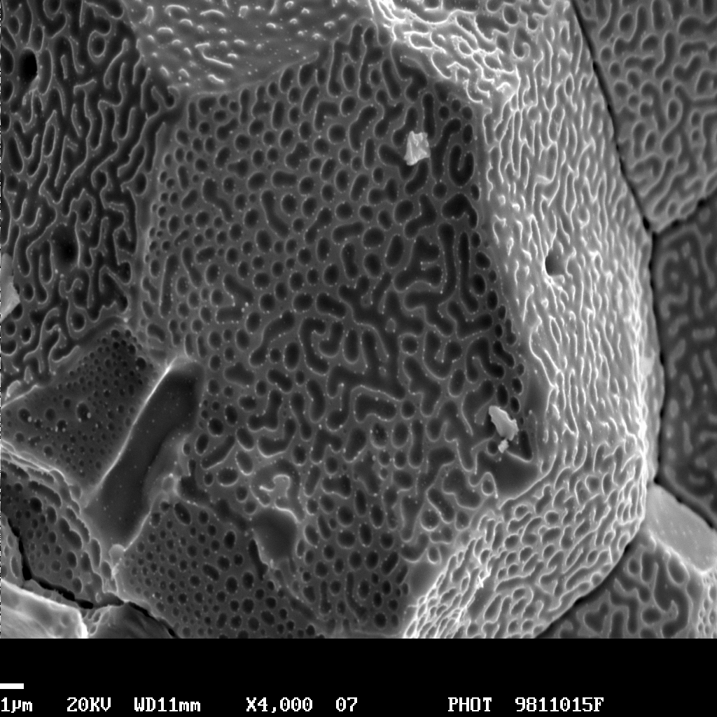
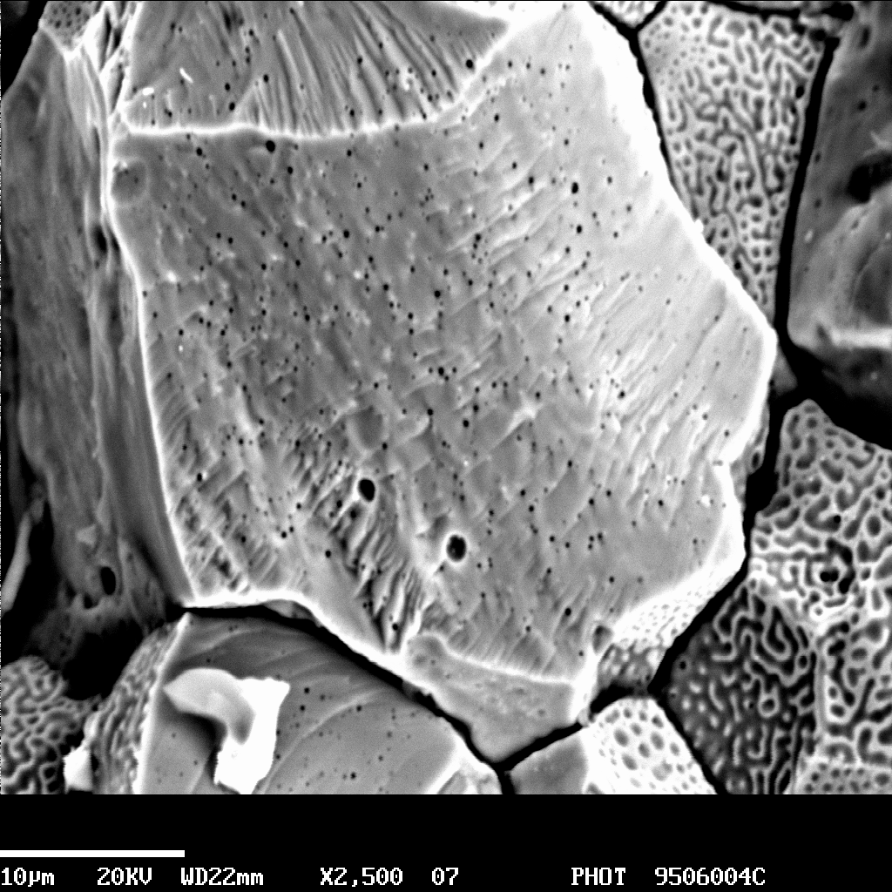
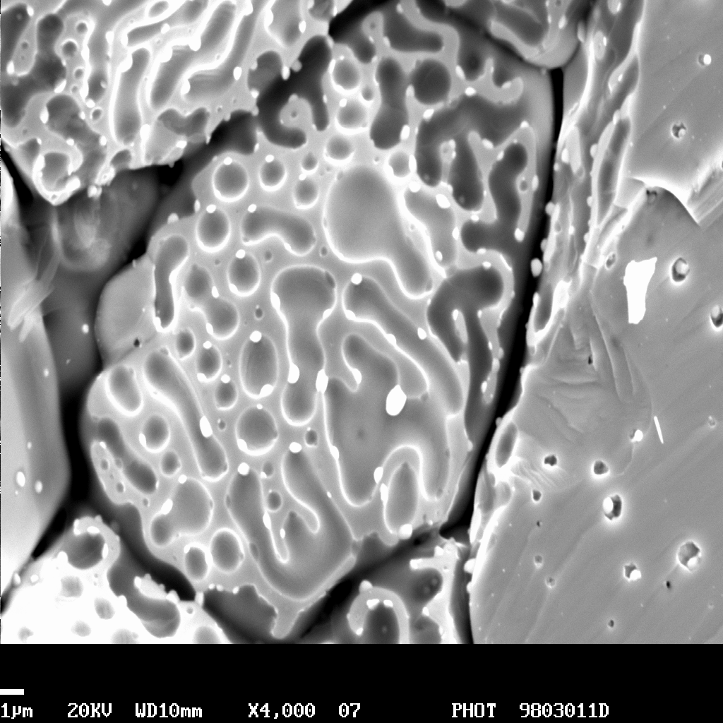
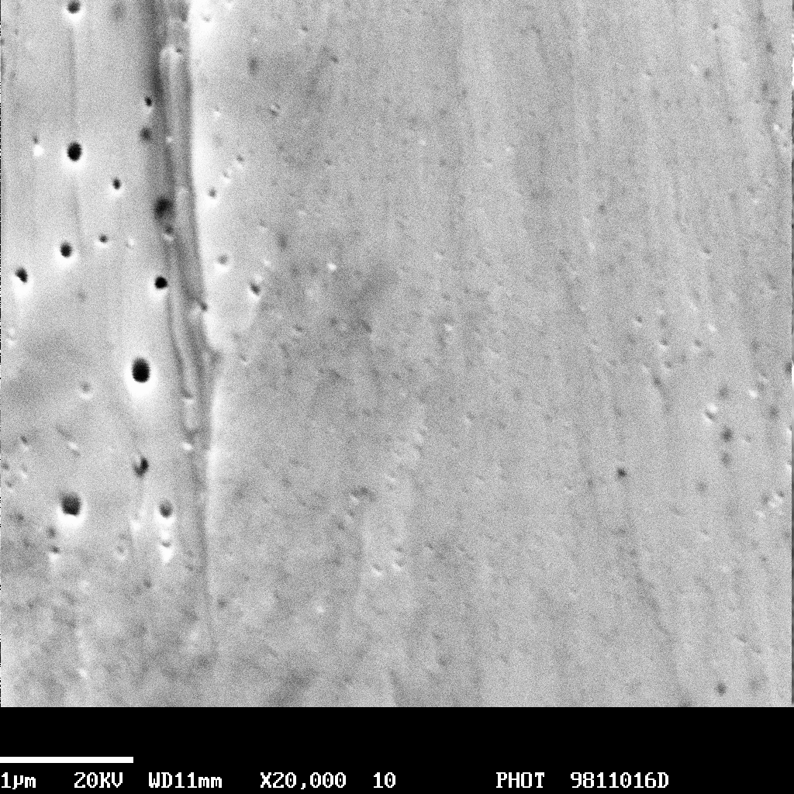
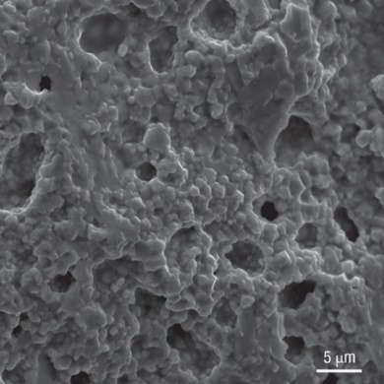
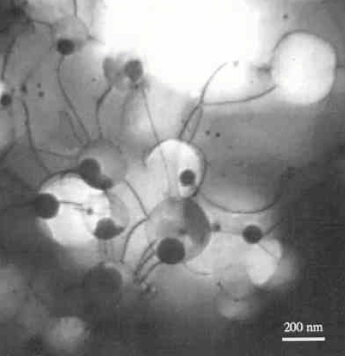
PHYSICAL PHENOMENA
Fission reactions
Generation of fission gases (Xe, Kr)
Intra-granular gas (single atoms)
Diffusion
Trapping
Inter-granular gas
(lenticular bubbles)
Intra-granular gas
(small bubbles)
Re-solution
Grain-boundary saturation and/or micro-cracking
Inter-granular bubble swelling
Intra-granular bubble swelling
Fission
gas release
High burnup structure
2/7

Slide 4
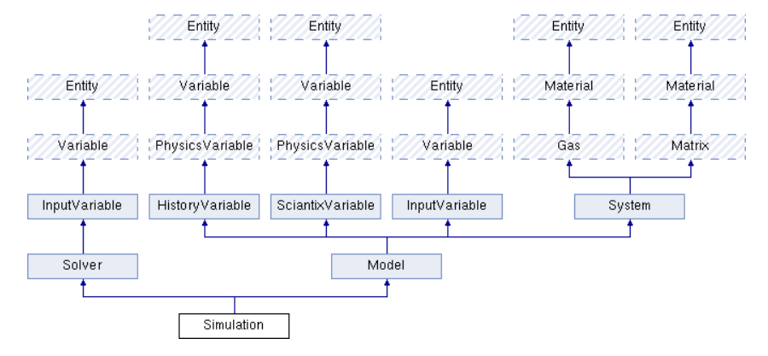
Zullo et al., JNM 587 (2023) 154744
SCIANTIX CODE: INHERITANCE DIAGRAM
Fission gas / Helium
in UO₂ / MOX
Fission gas / Helium behaviour
Production
Diffusion
(Solubility)
Interaction FG - He → bubbles
Intra- + inter-granular dynamics
3/7

Slide 5
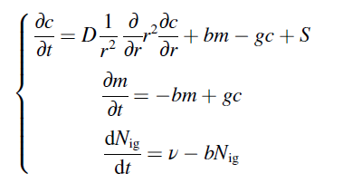
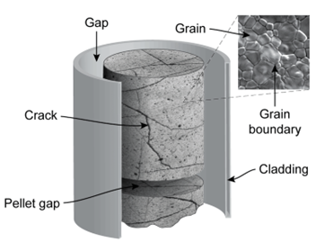
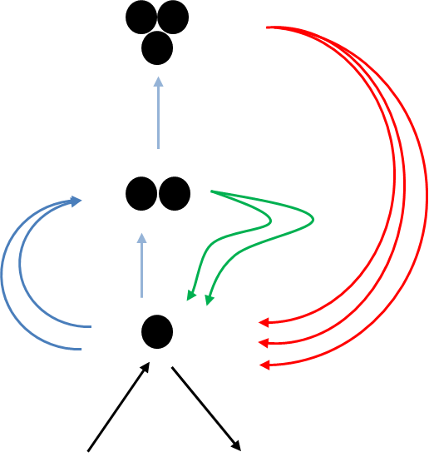
Pizzocri et al., JNM 532 (2020) 152042
Zullo et al., JNM 587 (2023) 154744
INTRA-GRANULAR
Fundamental parameters: diffusivity (single atoms), bubble nucleation, trapping, re-solution (w/ He solubility)
Physically-based single-size model derived from cluster dynamics (clusters with size n > 2 are counted as bubbles)
intra-granular gaseous swelling
Diffusion
Fission gas diffusivity: SetSystem.C → void System :: setFissionGasDiffusivity (int input_value)
4/7

Slide 6
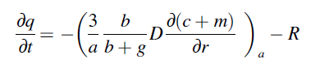
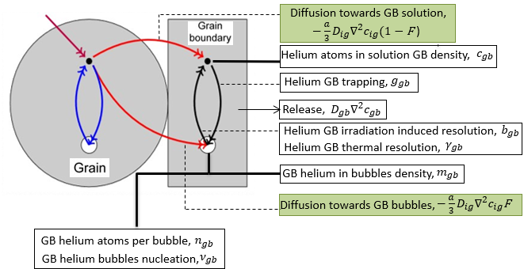
Pizzocri et al., JNM 532 (2020) 152042
Zullo et al., JNM 587 (2023) 154744
Giorgi et al., NET 54 (2022) 2367-2375
INTER-GRANULAR
Inert gas arriving from the intra-granular diffusion is accumulated directly within bubbles
Bubble growth and coalescence: grain-boundary over-pressurized due to fission gases → restore the equilibrium by absorption of vacancies → bubble growth → interconnection and coalescence → concentration decrease
→ inter-granular gaseous swelling
5/7

Slide 7
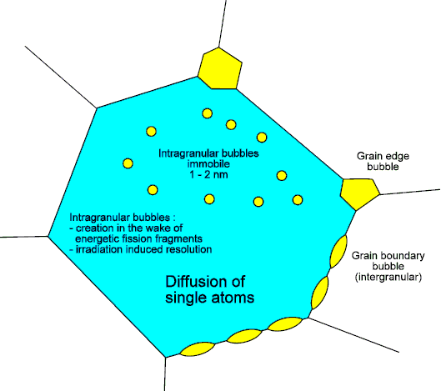
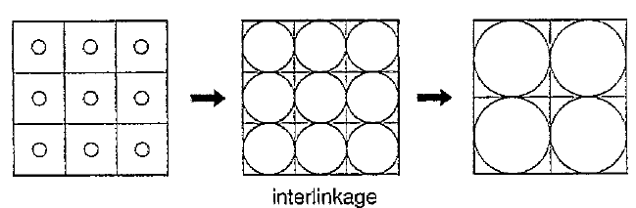
Pizzocri et al., JNM 532 (2020) 152042
Zullo et al., JNM 587 (2023) 154744
GAS RELEASE
Inter-granular bubble growth, interconnection and coalescence → increase of grain-face fractional coverage
A saturation value of the fractional coverage of the grain-faces is considered: 50% (reference value) → grain faces are vented, allowing for the (thermal or diffusional) release of gas from the grain boundaries
+ grain-boundary micro-cracking (non-diffusional release mechanism), venting, sweeping: input options
Fission gas release: Simulation.h,
from gas balance → gas produced – in grain – at grain boundaries
F_{c} increases
F_{c} = constant (FGR occurs)
6/7

Slide 8
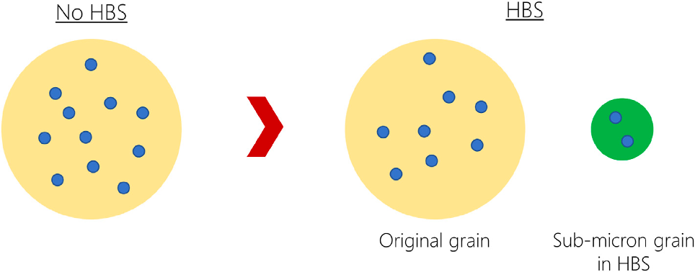
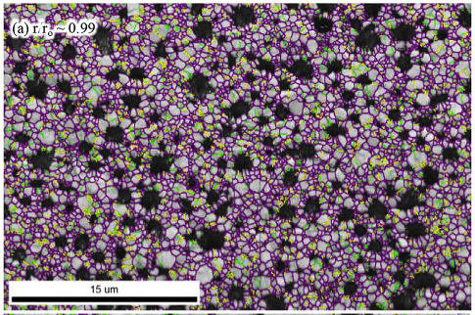
Zullo et al., JNM 587 (2023) 154744
Barani et al., JNM 539 (2020) 152296
Barani et al., JNM 563 (2022) 153627
HIGH BURNUP STRUCTURE (HBS)
Fuel material (matrix) representing the HBS, incorporating the properties of restructured fuel (e.g., grain size)
Models for HBS formation (function of effective burnup via restructured volume fraction) and HBS porosity (function of local burnup) → HBS pore size: semi-empirical via porosity and pore number density
Small fuel grains (radius 150 nm), physics-based modelling of gas diffusion and release neglecting intra-granular and inter-granular bubbles
HBS matrix:
SetMatrix.C, case 1 → UO2, UO2HBS
SetSystem.C, case 1 → Xe in UO2, Xe in UO2HBS
7/7

Slide 9
Zullo et al., JNM 587 (2023) 154744
SCIANTIX CODE: INHERITANCE DIAGRAM
Fission gas / Helium
in UO₂ / MOX
Fission gas / Helium behaviour
Production
Diffusion
(Solubility)
Interaction FG - He → bubbles
Intra- + inter-granular dynamics

Slide 10
SIMULATION CASES
One of the experimental UO₂ sample of Baker 1977 to showcase the SCIANTIX capabilities in a case of irradiation under constant conditions.
One of the experimental UO₂ sample of White et al. 2004 to showcase the SCIANTIX capabilities in a case of irradiation under transient conditions.
Test case representative of HBS irradiation conditions to showcase the HBS capabilities of SCIANTIX.

Slide 11
1 - BAKER CASE
The xenon produced (blue line) increases linearly as the product between the xenon fission yield and the fission rate.
A fraction of the gas produced remains in the grain (orange line) as gas in solution and gas in the bubbles.
The gas that reaches the grain boundary (green line) is eventually released (violet line) when the saturation of the grain boundary is reached.

Slide 12
1 - BAKER CASE
The initial increase of intra-granular bubble concentration is due to the nucleation.
As the intra-granular bubble radius increases steadily as a result of trapping, the intra-granular bubble concentration decreases with burnup.

Slide 13
2 - WHITE CASE
Base irradiation corresponds to the vertical line at 1157 K and the holding on top of the temperature ramp corresponds to the vertical line at 2048 K.
Moving right corresponds to the heating transient and moving left corresponds to the cooling transient
The increase of grain-boundary swelling during the base irradiation is due to the absorption of vacancy.
The reduction in grain-boundary swelling witnessed during the heating and cooling transient arises from the burst release triggered by grain-face separation due to fuel micro-cracking (Barani 2017).

Slide 14
3 - UO₂ HBS CASE

Slide 15
3 - UO₂ HBS CASE

Slide 16
RECAP ON BASIC TUTORIAL
Github repository of SCIANTIX: https://github.com/sciantix/sciantix-official
includes "training" branch with materials of today’s tutorials
phenomena & implementation: introduction to basic physical phenomena modelled in SCIANTIX
gas production, intra- + inter-granular dynamics, release, HBS matrix
input files: history, settings, initial conditions, scaling factors → available options, use
representative simulation cases: experimental, from SCIANTIX regression database
constant (Baker), transient (White), HBS (Cappia) irradiation conditions
outputs & plots: intra- + inter-granular, HBS pore evolutions (in comparison with available data)
You will receive a link to an online survey on tutorials (feedback & suggestions)
Thank you for participating!

Slide 17
REFERENCES
C. Baker, The fission gas bubbles distribution in uranium dioxide from high temperature irradiated SGHWR fuel pins, J. Nucl. Mater. 66 (1977) 283–291.
T. Barani, D. Pizzocri, F. Cappia, L. Luzzi, G. Pastore, P. Van Uffelen, Modeling high burnup structure in oxide fuels for application to fuel performance codes. part I: high burnup structure formation, J. Nucl. Mater. 539 (2020), https://doi. org/10.1016/j.jnucmat.2020.152296.
T. Barani, D. Pizzocri, F. Cappia, G. Pastore, L. Luzzi, P. Van Uffelen, Modeling high burnup structure in oxide fuels for application to fuel performance codes. Part II: porosity evolution, J. Nucl. Mater. 563 (2022), https://doi.org/10.1016/ J.JNUCMAT.2022.153627.
R. Giorgi, et al., Physics-based modelling and validation of inter-granular helium behaviour in SCIANTIX, Nucl. Eng. Technol. 54 (7) (Jul. 2022) 2367–2375, https://doi.org/10.1016/J.NET.2022.01.012.
D. Pizzocri, T. Barani, L. Luzzi, SCIANTIX: a new open source multi-scale code for fission gas behaviour modelling designed for nuclear fuel performance codes, J Nucl Mater 532 (2020) 152042, https://doi.org/10.1016/j.
G. Zullo, D. Pizzocri, L. Luzzi, The SCIANTIX code for fission gas behaviour: Status, upgrades, separate-effect validation, and future developments, Journal of Nuclear Materials 587 (2023) 154744. doi:10.1016/J.JNUCMAT.2023.154744.
R.J. White, The development of grain-face porosity in irradiated oxide fuel, J. Nucl. Mater. 325 (1) (2004) 61–77, https://doi.org/10.1016/j. jnucmat.2003.10.008.
R. White and J.A. Turnbull, “IFPE/CAGR-UOX-SWELL, Fuel swelling Data Obtained from the AGR/Halden Ramp Test Programme.” Jun. 06, 2006. Available: https://inis.iaea.org/search/search.aspx?orig_q=RN:40064987.

